Slide 1
Telling a Story with Jupyter Notebooks
Files needed today:
high_quality_notebook.ipynb [canvas]
low_quality_notebook.ipynb [canvas]
Dr. Groves
Dr. Peirce-Cottler
Module 0 Lecture 3
Learning objective: I can recognize what makes a Jupyter notebook high quality and can implement story-telling and visualization in my own notebooks.

Slide 2
Communicating results is a key skill for engineers
What audience might you present a research project to?
What are some considerations to effectively reach each audience?
What makes an effective written presentation of research?

Slide 3
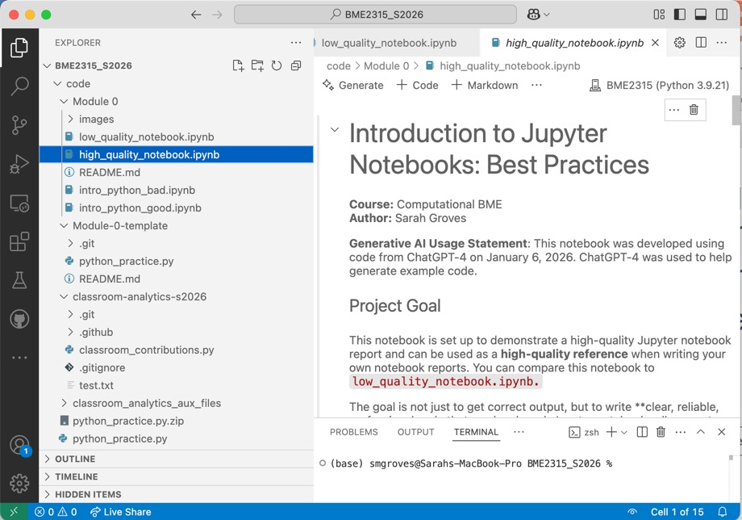
Getting started with Jupyter Notebooks
We downloaded the Jupyter extension to run them in VS code
We installed the ipykernel package
File extension: .ipynb

Slide 4
LET’S PRACTICE! Open low_quality_notebook.ipynb & write a list of problems with a partner

Slide 5
What does a high-quality notebook look like?
Organized report
Headers
Markdown text explanations
Code snippets in several blocks
Can even add images!
Tells a story
Clearly explains though process
Flow from one code block to the next is explained in words
Visualizes results with plots
Hides or minimizes “ugly” output
Considers the audience of the report
In this class, the audience is your partner and your TAs/instructor!
In the future, this might be your employer, a client, a research journal, or other Python users

Slide 6
Example notebooks
Organized report
High quality (exceeds expectations)
Low quality (Meets or doesn’t meet expectations)
Uses markdown to organize code blocks
Header: #, ##, ###, …
Bold: **text**
Italic: *text*
Code in MD: `code`
Code blocks are separated by reasonable “chunks” or steps
All code in a single block
No headers to orient reader
No title/name

Slide 7
Example notebooks
Tells a story
High quality (exceeds expectations)
Low quality (Meets or doesn’t meet expectations)
Answers the following questions so reader can step through your notebook like reading a report:
What’s the goal?
What steps were executed and why?
If something went wrong, how was it fixed?
What are the conclusions?
Only code
Doesn’t explain reasoning
Doesn’t consider the audience

Slide 8
Example notebooks
Visualizes results with plots
High quality (exceeds expectations)
Low quality (Meets or doesn’t meet expectations)
Includes plots with titles, axis labels, and legends
The plots are scaled so that everything is readable
No plots
Plots without labels

Slide 9
Example notebooks
Hides or minimizes “ugly” output
High quality (exceeds expectations)
Low quality (Meets or doesn’t meet expectations)
Doesn’t print out any unnecessary code from development
Print statements are clearly labeled when the output is useful to the reader
Print(“Correlation value: ”, corr_value)
Imports auxillary functions from other files
Unnecessary print statements (e.g. print(dataframe) = prints the entire dataframe over many pages)
Variable print statements used for troubleshooting/debugging
Includes all the code written for the project, without hiding background functions

Slide 10
Homework due Tuesday January 27, 2026
In Canvas, submit the Module 0 assignment with a link to your github repo
Reference the rubric to see what will be expected:
Module 0 repo with
README file,
Another branch,
Python_practice.py pushed to that branch (maybe multiple times!)
A high-quality version of the low_quality_notebook.ipynb file
Pull request from your branch to main when done with developing
Write a review comment and accept the merge into the main branch

